Slide 1
Capstone-The-Battle-of-Neighborhood
Quality of the Thai Restaurant in New York City

Slide 2
Introduction
New York City is the center of east coast and food there is really good
What is the best location to enjoy Asian food, specifically Thai food in NYC
Is it a good idea to open a Thai restaurant in NYC now?

Slide 3
Methodology
Data will be collected from https://cocl.us/new_york_dataset , which has been used as an example before, and cleaned and processed into a data frame. This dataset is quite easy to be accessed for me.
FourSquare be used to locate all venues and then filtered by Asian restaurants. Ratings, tips, and likes by users will be counted and added to the data frame.
Data will be sorted based on rankings and be visually assessed by using graphing from Python libraries (e.g numpy, pandas, folium etc).

Slide 4
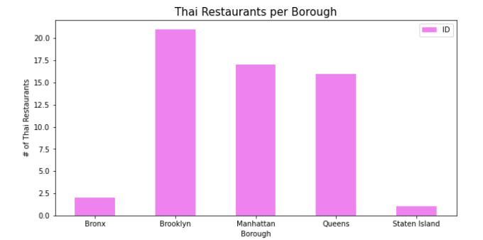
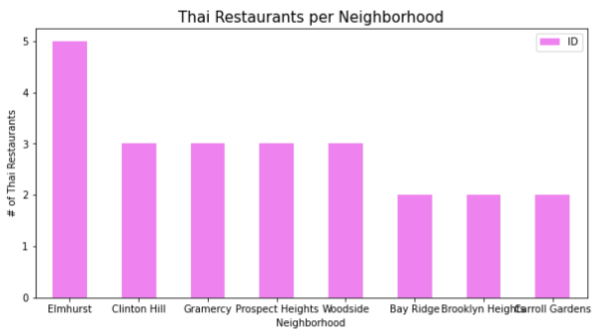
Results
It is obvious that mainly Brooklyn, Manhattan and Queens have major Thai restaurants

Slide 5
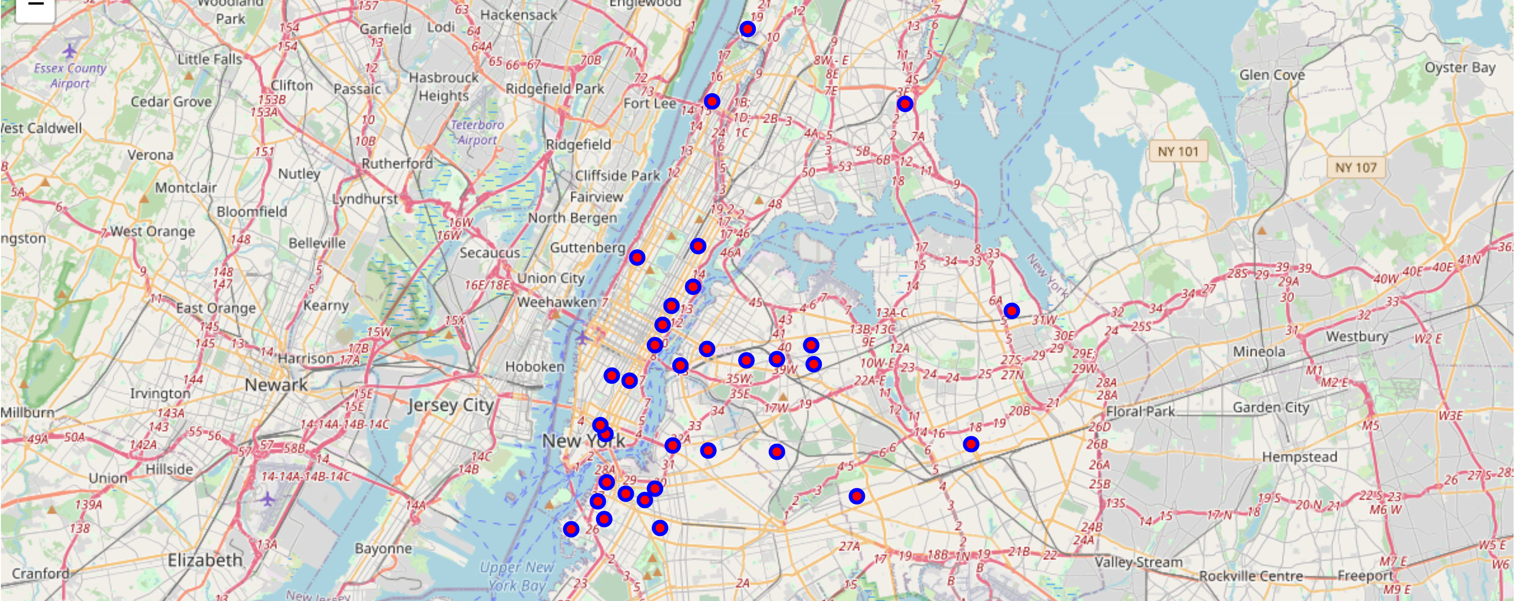
The map we obtained from folium also shows the same result.

Slide 6
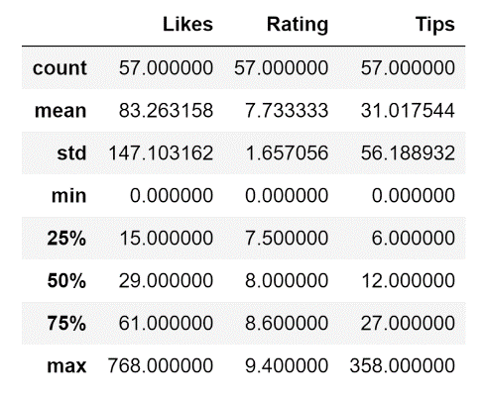
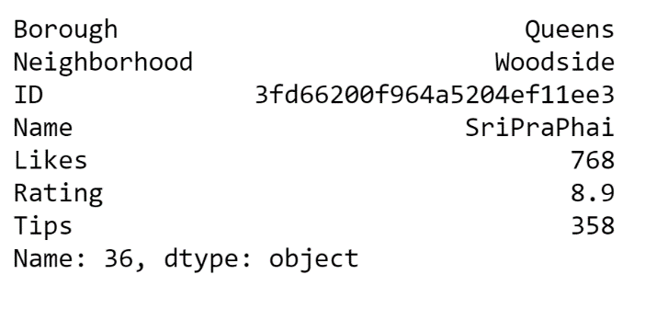
The best rating Thai restaurant in New York City
The overall information for all Thai restaurants

Slide 7
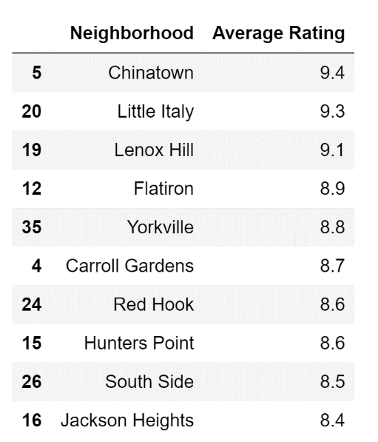
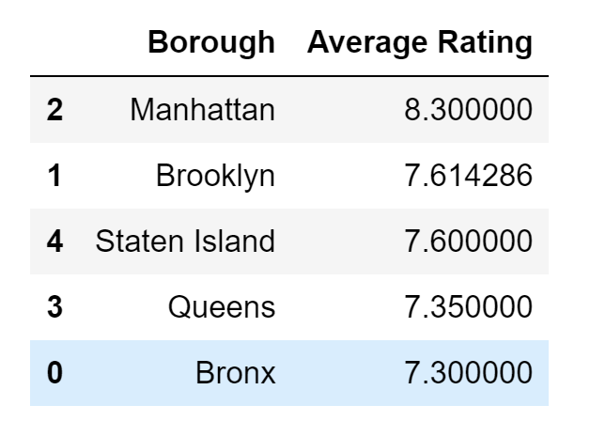
To our surprise, rather than Queens borough, Manhattan borough has the best overall rating of Thai restaurants. The number of Thai restaurants is not as large as Brooklyn and Queens but the average rating is surprisingly much higher than other boroughs.

Slide 8
More Things for Exploratory
Why does Brooklyn, which has most number of Thai restaurants, not obtain the champion for the best location: Is there any outlier effect affecting our results?
Need some other tools and data resource for considering if the price of high rating Thai restaurant is affordable the public, e.g students
The ratings for the public may not be quite reliable and some ratings may be from professionals while others may be from amateurs. The weights of different type of ratings should be considered

Slide 9
Conclusion
On average, Manhattan may be the best borough to enjoy Thai food
Overall, New York City has 57 Thai restaurants and overall rating is good.
It may not be a good choice to open a Thai restaurant now due to high competition.

